Slide 1
Visualizing Loss Landscapes of Neural Nets

Slide 2
Background
1D Interpolation:
Choose 2 sets of parameters;
Plot values of loss function along line connecting these points
Alpha is used to parameterize the line
Drawback: Non-convexities are hard to visualize in 1D
Contour Plots
Choose center in graph, theta*
Choose two direction vectors eta and delta
Drawback: low-res plots that might not capture complexity of loss surface

Slide 3
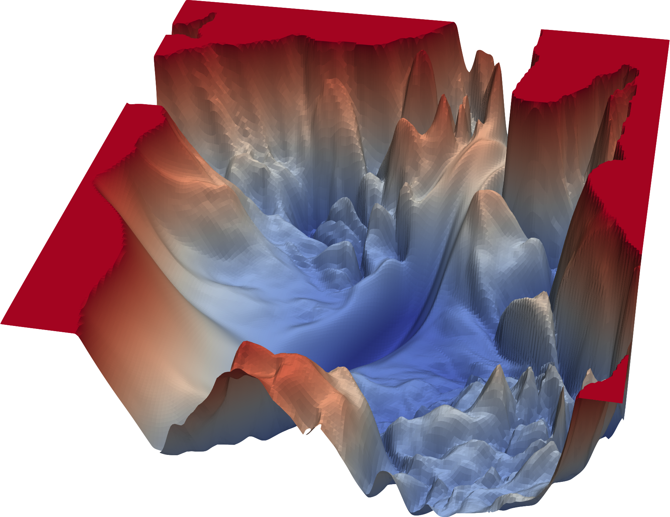
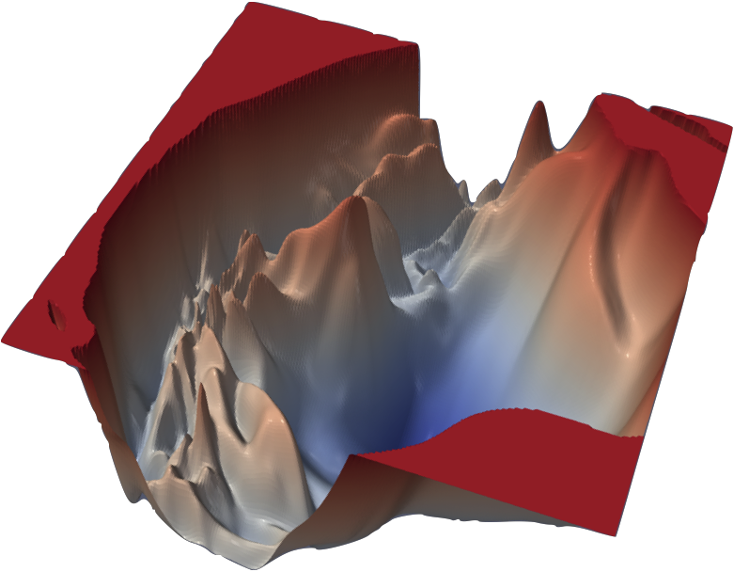
Motivation/Context
Is there a significant effect of training parameters (like batch size) on loss landscapes of deep neural nets?
Effect of loss landscapes on generalization
Due to size of the weights and high-dimensionality, it is difficult to visualise loss landscapes.
Previous methods include:
1D Interpolation
2D Random directions (Contour plots)

Slide 4

Proposed Approach: Filter-wise Normalization
Compute a random gaussian vector d with dimensions same as θ
Normalize each filter in d such that it has same norm as corresponding filter in θ.
Applied to Conv and FC layers

Slide 5
Experimental Setup
Flow of experiment is:
Train models on a dataset or load a pretrained model
Extract model parameters
Generate random vectors and apply filter normalization method
Calculate loss values across the grid of possible values
Plot the loss landscapes

Slide 6
Experimental Setup
We experiment with a battery of models and hyperparameters to investigate the effect of model choices and training dynamics with respect to the loss function.
In particular, we train the following on CIFAR-10 dataset:
Linear Layer Models
CNN Model (with skip connections)
CNN Model (without skip connections)
Additionally, we also visualize the contour plots of the pretrained MobileNet model.

Slide 7
Research Question
What effect does batch size have on loss landscape and generalization across different models, (trained from scratch or pretrained)?

Slide 8
Results
Linear Layer model on Cifar-10 dataset:
Batch Size Used: 64 & 512
Learning rate: 5e-4
Optimizer: Adam

Slide 9
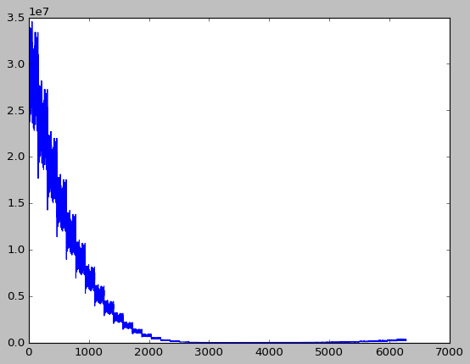
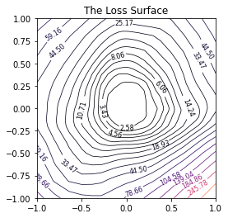
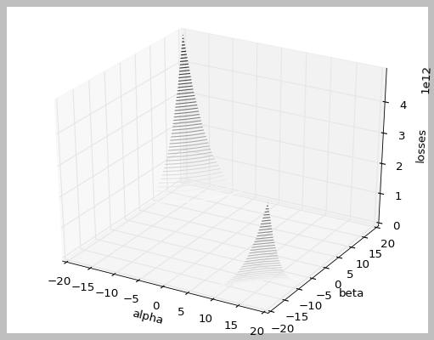
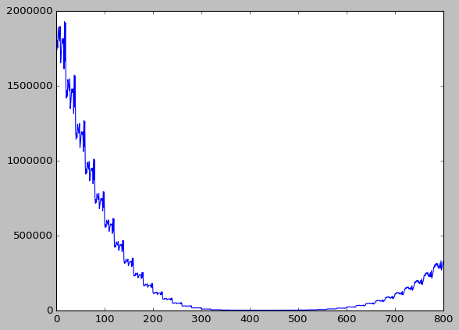
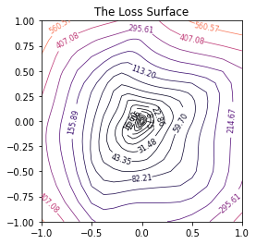
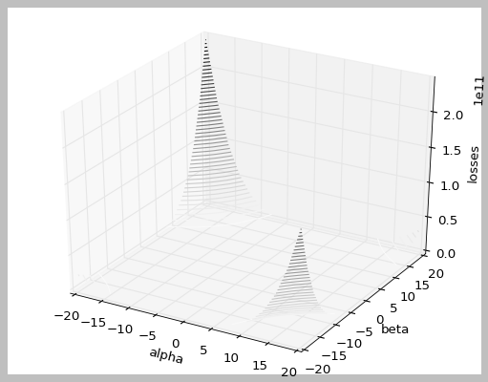
Batch size: 64
Batch size:512

Slide 10
Results
Convolution Layer model(without skip connection) on Cifar-10 dataset:
Batch Size Used: 64 & 512
Learning rate: 5e-4
Optimizer: Adam

Slide 11
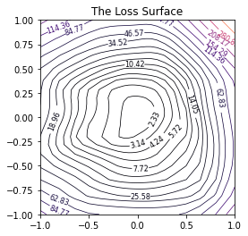
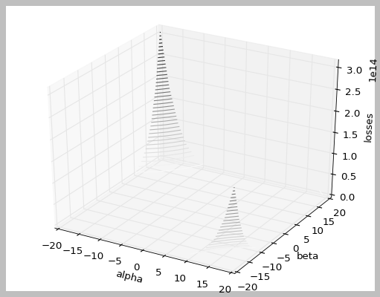
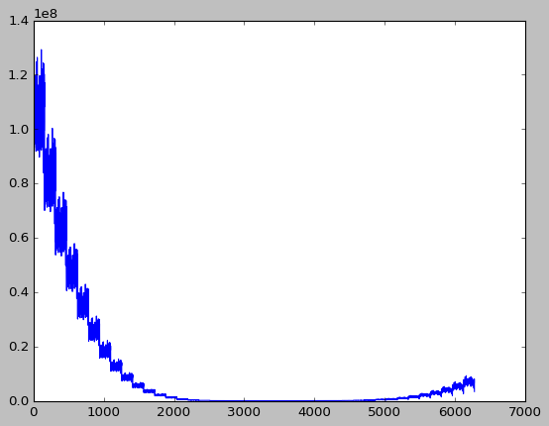
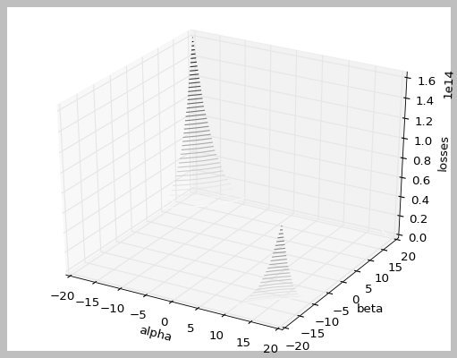
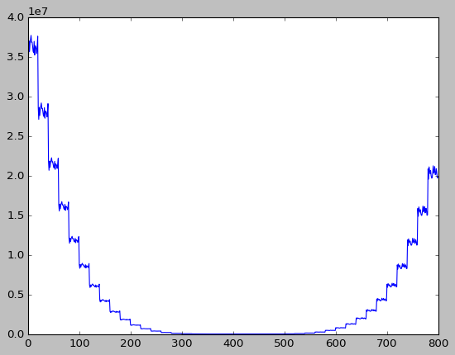
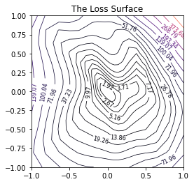
Batch size: 64
Batch size:512

Slide 12
Results
Convolution Layer model (with skip connection) on Cifar-10 dataset:
Batch Size Used: 64 & 128
Learning rate: 5e-4
Optimizer: Adam

Slide 13
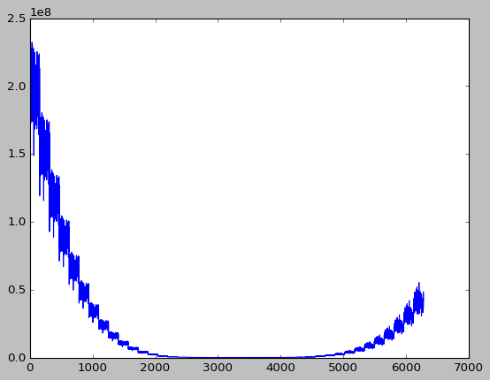
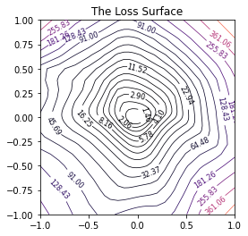
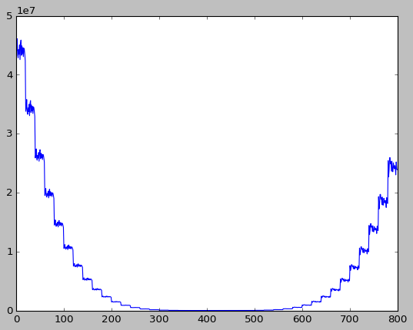
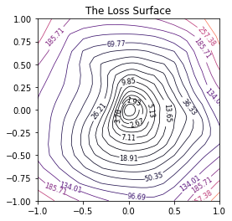
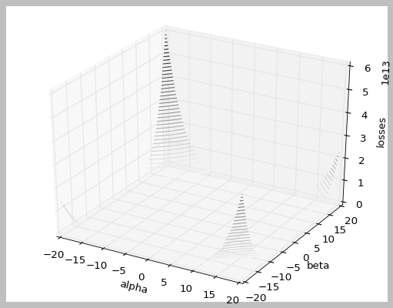
Batch size: 64
Batch size: 512

Slide 14
Results
MobileNet trained on ImageNet dataset:
Batch Size Used: 64 & 512
Pretrained weights

Slide 15
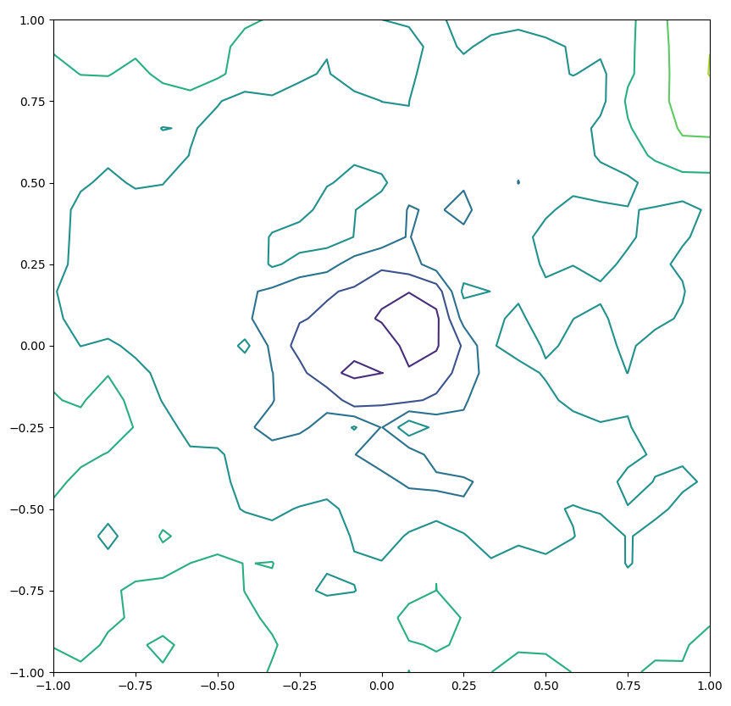
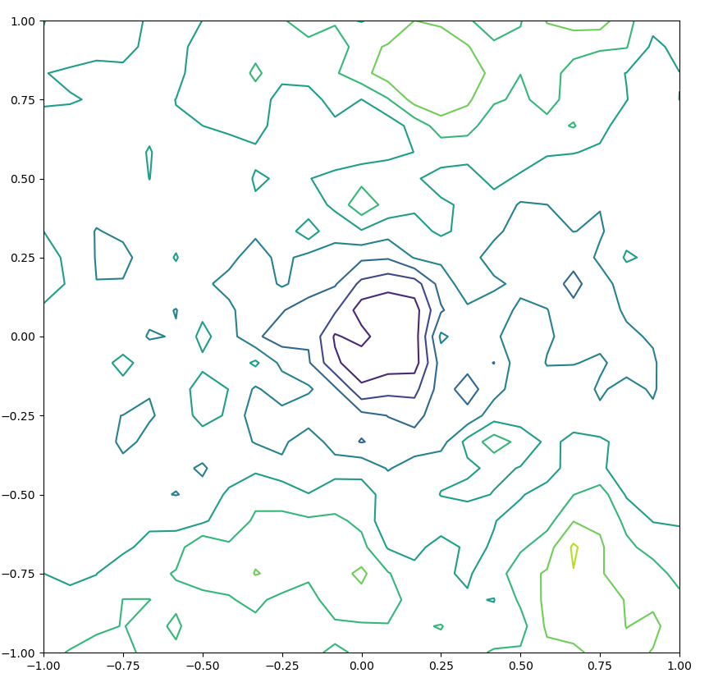
Batch size:8
Batch size: 32
Note: Since MobileNet has ~3M parameters, it was computationally very expensive to generate multiple plots for it.

Slide 16
Observations
We observe that, smaller batch sizes lead to loss landscapes which are:
More convex
Less chaotic
Have wide regions of convexity
In the contour plots, we clearly see that loss is minimum in regions of high convexity.
These visualizations help us in disentangling the mysteries of deep learning and what factors influence its dynamics.
From the original paper:
BatchNorm results in better and smoother loss landscapes
VGG models have landscapes with multiple local minima

Slide 17
Future Work
We planned to implement the loss visualizations on NLP models like BERT, etc.
Generate ways to plot in higher resolutions.
Make the process computationally less expensive.

Slide 18
Thank you

Slide 19
Paper at a glance
Certain network architectures produce “smoother” loss functions which converge easier. Why and how this happens is unknown.
Using a range of visualization methods, this paper plots the loss landscape of neural nets (with millions of parameters) to explore the effect of various model choices on convergence and generalization. Three methods:
1D Interpolation
2D Landscape
3D Landscape
Directly comparing loss landscapes of models is hard because:
Many types of layers (like ReLU) do not contribute to loss landscape
Perturbing large weights has very little effect on the model
To tackle this, Feature Normalization is proposed where the randomly generated vectors are normalised to have the same direction as the parameter vectors.

Slide 20
Project Scope
We plan to implement the Filter Normalization approach for a variety of neural networks.
In order to have meaningful insights, we plan to contrast the loss landscapes of trained models based on the following settings:
Large vs small batch size
Skip connections
Random vectors vs pretrained vectors
Effect of network depth
We will then draw inferences on the types of landscapes induced by various network choices. Possible pointers to look for are:
Chaotic landscapes
Shallow valleys
Train/Test Error and how they relate with the landscapes
Flatter valleys
We have started implementing the project here: https://github.com/Ravi2308/Visualizing-the-Loss-Landscape-of-Neural-Nets

